Slide 1
Ethical Consumerism
UK
Lecture Listening
By AEUK
https://www.academic-englishuk.com/listening-tests

Slide 2
Outline
Overview
Definition
Ethical consumers & problems
Ethical consumerism movement
Summary

Slide 3
Overview
Ethical
How far are your spending habits affected by your ethical considerations?

Slide 4
Definition
Marylyn Carrigan
Keel University
an ethical consumer is…

Slide 5
Ethical Consumption Gap
Consumers
Figures / Sales

Slide 6
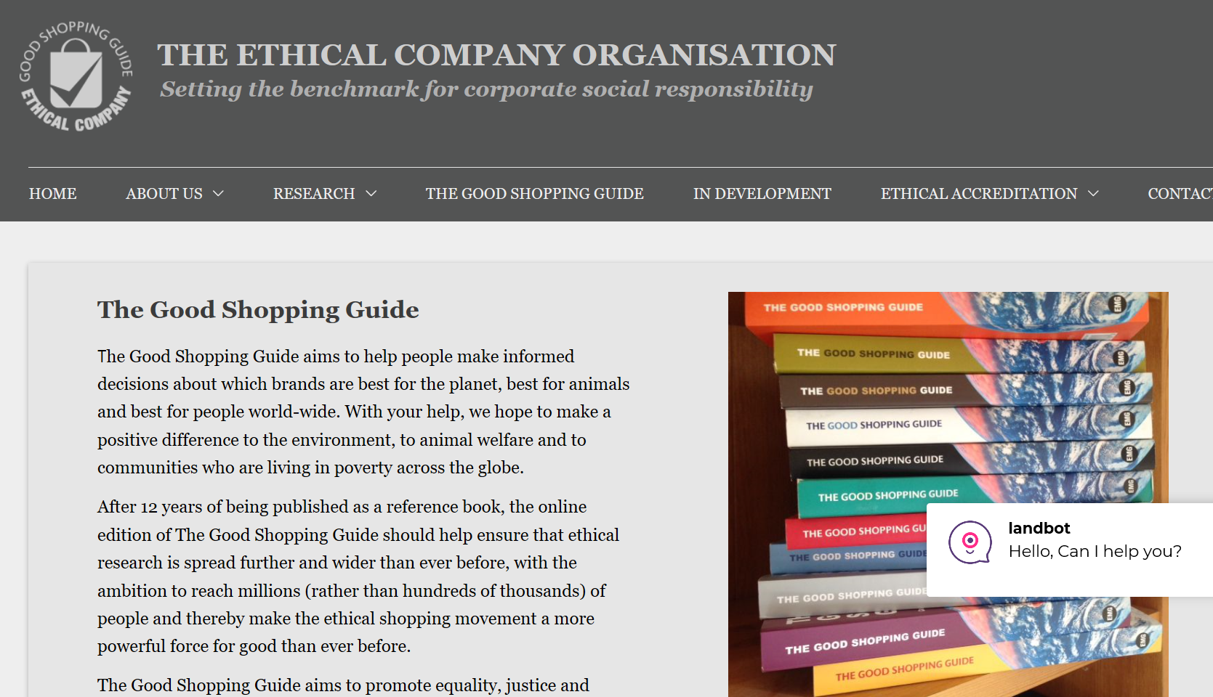
More information
C.S.R
Ethical Brands
Criteria
Banks
Energy

Slide 7
Consumers??
Rational
McKinsey Report
Irrational
Capricious

Slide 8
Ethical awareness

Slide 9
Ethical awareness

Slide 10
Summary
Overnight
Governments
TV/Media
Consumer power
YOU need to take responsibility of YOUR actions and YOU are now accountable for YOUR existence on this planet.

Slide 11
There is a listening test worksheet for this lecture
UK
https://www.academic-englishuk.com/listening-tests

