Slide 1
AI in Higher Education
Academic
A
E
English
UK
Opportunities, Risks and Assessment
www.academic-englishuk.com/ai-in-education

Slide 2

Lecture Outline
Definition
AI Applications
Limitations
Resilient Assessments
Conclusion
.
www.academic-englishuk.com/ai-in-education

Slide 3
Research
Current guidance: UK Government alongside
Policies and Practice Papers: UK universities
[Glasgow, Leeds, Reading, Sussex, Manchester, Edinburgh, King’s College London, Leicester, Liverpool and Newcastle].
All sources (1-16) provided at end of presentation.
www.academic-englishuk.com/ai-in-education

Slide 4
AI Definition
Generative Artificial Intelligence, or Gen AI, refers to tools that can create new content such as texts, images, code, and simulations. In education, these tools can help students by providing instant feedback, personalised study support, and realistic practice scenarios.
However, they also present challenges. For example, they can spread false information, raise ethical concerns, and reduce genuine critical thinking if used without care or proper evaluation (1-5).
AI = umbrella term for all forms of artificial intelligence.
Generative AI = a specific type of AI designed to produce new data, not just process or recognize it.
www.academic-englishuk.com/ai-in-education

Slide 5
A Recent Survey
Oxford Higher Education Policy Institute (2025):
“88% of UK university students admitted to using generative AI tools (e.g. ChatGPT) for assessments”.
Source: (6)
www.academic-englishuk.com/ai-in-education

Slide 6
AI Applications
What do students use AI for at university?
www.academic-englishuk.com/ai-in-education

Slide 7
AI Applications
Personalised Learning
Simulations and Scenarios
Assessment and Feedback
Accessibility
Source: (1,4,5)
www.academic-englishuk.com/ai-in-education

Slide 8
AI Applications
Text Manipulation
Idea Generation
Productivity Support
Source: (1,4,5)
www.academic-englishuk.com/ai-in-education

Slide 9
Limitations and Risks
www.academic-englishuk.com/ai-in-education

Slide 10
Limitations and Risks
1) Reliability and Accuracy
Errors
Truth
Hallucinations
Algorithmic Drift
Source: (2-9)
www.academic-englishuk.com/ai-in-education

Slide 11
Limitations and Risks
2) Bias and Fairness
Stereotypes
Transparency
Accountability
Evaluation
Source: (2-9)
www.academic-englishuk.com/ai-in-education

Slide 12
Limitations and Risks
3) Academic Integrity
Plagiarism
Dishonesty
Competence
Independence
Source: (2-9)
www.academic-englishuk.com/ai-in-education

Slide 13
Limitations and Risks
4) Data Privacy and Compliance
Personal data breaches
Third party vendors
Copyrighted material
Intellectual property
Source: (2-9)
www.academic-englishuk.com/ai-in-education

Slide 14
Limitations and Risks
5) Ethical and Social Concerns
Institutional values
Academic freedom
Creativity
Professional expertise
Source: (2-9)
www.academic-englishuk.com/ai-in-education

Slide 15
Designing AI Resilient Assessments
www.academic-englishuk.com/ai-in-education

Slide 16
Designing AI Resilient Assessments
Invigilated and On-Campus Components
Contextual and Localised Assessment Tasks
Interlinked and Developmental Assessment
Source: (2-9)
www.academic-englishuk.com/ai-in-education

Slide 17
Designing AI Resilient Assessments
Higher-Order Thinking and Critical Engagement
Authentic and Scenario-Based Tasks
Incorporation of AI within Assessment
Source: (2-9)
.
www.academic-englishuk.com/ai-in-education

Slide 18
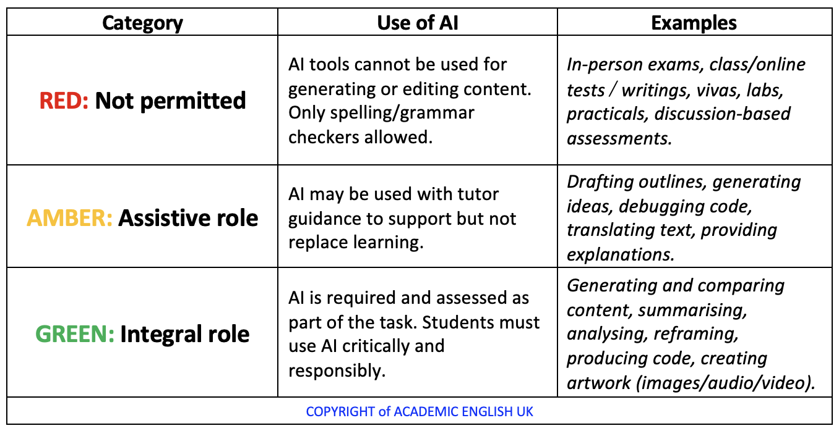
The AI Traffic Light System
www.academic-englishuk.com/ai-in-education
Source: (10-14)

Slide 19
Paper and Pen Tests
Liverpool University emphasises that assessments must “never replace original thought, independent research, and the production of original work,” recommending traditional, invigilated, handwritten formats as part of a wider strategy to safeguard authenticity and uphold academic integrity (15).
Newcastle University recommends using assessment formats that “are less vulnerable to AI misuse, such as invigilated, in-person pen and paper exams, to preserve academic integrity in a world where generative AI is widely accessible” (16).
www.academic-englishuk.com/ai-in-education

Slide 20
Paper and Pen Tests
Test Type | What It Assesses | How It Resists AI
Closed-book exam | Recall of knowledge, understanding of core concepts | No access to devices; relies on memory and preparation.
Open-book exam (on paper) | Application of knowledge using permitted notes | Still handwritten; AI tools are inaccessible in the exam room.
Short-answer test | Definitions, key terms, quick factual recall | Time-limited, handwritten; students must rely on their own knowledge.
Essay questions | Critical thinking, argument building, synthesis | Handwritten under invigilation; cannot copy from AI.
Problem-solving tasks | Application of formulas, calculations, logical reasoning | Requires step-by-step working out by hand.
Data analysis | Interpreting charts, graphs, or tables | Visual data interpretation, not easily outsourced to AI in exam conditions.
Critical commentary | Evaluation of a short text, image, or extract | Students must analyse unfamiliar material independently.
Translation test | Language skills, vocabulary, grammar accuracy | Handwritten; no access to online translation or AI tools.
Diagram labelling/drawing | Visual knowledge, spatial understanding | Requires manual recall of terminology and drawing ability.
www.academic-englishuk.com/ai-in-education
Source: (7-11)

Slide 21
Conclusion
AI > transforming higher education.
AI > enhance learning > personalisation > improve accessibility.
Risks > accuracy > ethics > academic integrity.
Design assessments > core values.
IMP: not to resist AI but to integrate it responsibly.
www.academic-englishuk.com/ai-in-education

Slide 22
Final Thoughts
Is generative AI helping us learn more deeply or simply making it easier to appear as though we have?
www.academic-englishuk.com/ai-in-education

Slide 23
References
Department for Education. Generative artificial intelligence (AI) in education [Internet]. GOV.UK; 2023 [cited 2025 Sep 26]. Available from: https://www.gov.uk/government/publications/generative-artificial-intelligence-in-education/generative-artificial-intelligence-ai-in-education
University of Glasgow. Artificial intelligence in learning: important limitations and problems [Internet]. 2024 [cited 2025 Sep 26]. Available from: https://www.gla.ac.uk/myglasgow/sld/ai/students/#ai%3Aimportantlimitations%2Cimportantproblems
UK Parliament. Artificial intelligence: education and impacts on children and young people [Internet]. Parliamentary Office of Science and Technology (POST); 2023 [cited 2025 Sep 26]. Available from: https://post.parliament.uk/artificial-intelligence-education-and-impacts-on-children-and-young-people/
University of Reading. Generative AI and university study: limitations [Internet]. LibGuides; 2024 [cited 2025 Sep 26]. Available from: https://libguides.reading.ac.uk/generative-AI-and-university-study/limitations
University of Edinburgh. Introducing AI in our learning technology [Internet]. Information Services; 2024 [cited 2025 Sep 26]. Available from: https://information-services.ed.ac.uk/learning-technology/more-about-learning-technology/introducing-ai-in-our-learning-technology-1
Freeman, J. (2025) Student Generative AI Survey 2025 (HEPI Policy Note 61). Oxford: Higher Education Policy Institute and Kortext. Available at: https://www.hepi.ac.uk/wp-content/uploads/2025/02/HEPI-Kortext-Student-Generative-AI-Survey-2025.pdf (Accessed: 30 September 2025).
King’s College London. Authentic assessment: approaches to assessment in the age of AI [Internet]. 2024 [cited 2025 Sep 26]. Available from: https://www.kcl.ac.uk/about/strategy/learning-and-teaching/ai-guidance/approaches-to-assessment/authentic-assessment
University of Sussex. Developing writing assignments [Internet]. Staff guidance; 2024 [cited 2025 Sep 26]. Available from: https://staff.sussex.ac.uk/teaching/enhancement/support/assessment-design/developing-writing-assignments
Wheeler S. Designing AI resilient assessment [Internet]. University of Manchester; 2024 [cited 2025 Sep 26]. Available from: https://personalpages.manchester.ac.uk/staff/stephen.wheeler/blog/0024_designing_ai_relilient_assessment.htm
University of Leeds. GenAI quick checklist [Internet]. Generative AI at Leeds; 2024 [cited 2025 Sep 26]. Available from: https://generative-ai.leeds.ac.uk/ai-and-assessments/gen-ai-quick-checklist/
University of Edinburgh. Using generative AI: guidance for students [Internet]. Information Services; 2024 [cited 2025 Sep 26]. Available from: https://information-services.ed.ac.uk/computing/communication-and-collaboration/elm/generative-ai-guidance-for-students/using-generative
Biesta G. The beautiful risk of education. Boulder: Paradigm Publishers; 2013.
Freire P. Pedagogy of the oppressed. New York: Herder and Herder; 1970
Leicester. Academic quality and standards [Internet]. University of Leicester; [cited 2025 Sep 26]. Available from: https://le.ac.uk/policies/quality
University of Liverpool. Guidance on the Use of Generative AI (Teach, Learn & Assess) [Internet]. 2024 [cited 2025 Sep 28]. Available from: https://www.liverpool.ac.uk/media/livacuk/centre-for-innovation-in-education/digital-education/generative-ai-teach-learn-assess/guidance-on-the-use-of-generative-ai.pdf
Newcastle University. AI in Assessment [Internet]. Newcastle: Newcastle University; 2023 [cited 2025 Sep 28]. Available from: https://www.ncl.ac.uk/learning-and-teaching/effective-practice/ai/ai-in-assessment/
www.academic-englishuk.com/ai-in-education

