Slide 1

Conservation of the Terracotta Army
UK
Lecture Listening
By A. Murphy (2025)
www.academic-englishuk.com/listening-tests

Slide 2
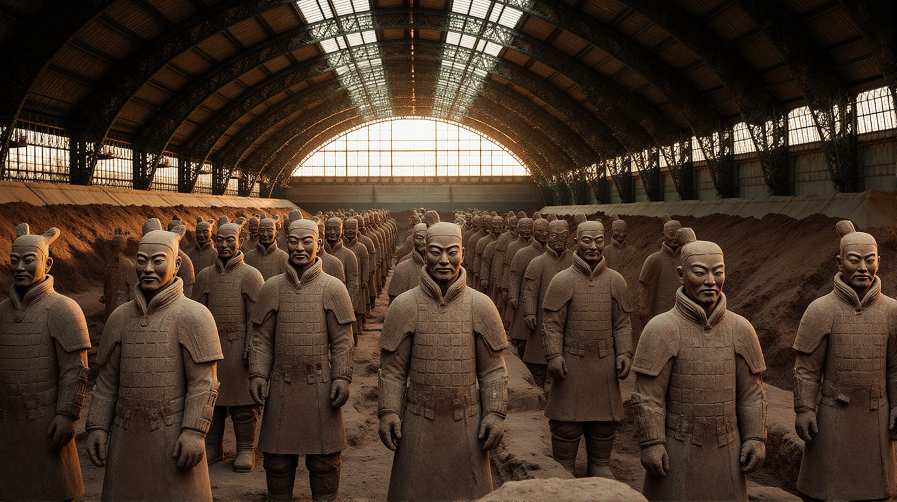
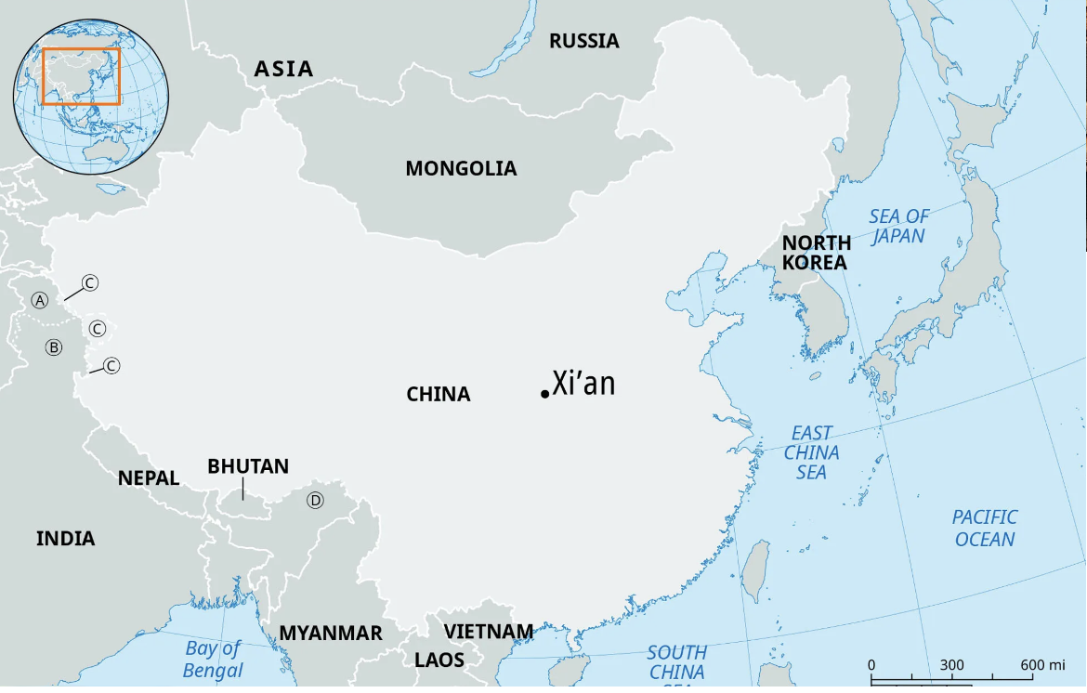

Introduction

Slide 3
Outline
The discovery.
Problems.
Scientific techniques.
Debates.
International cooperation.
Ongoing risks.
Broader significance.

Slide 4
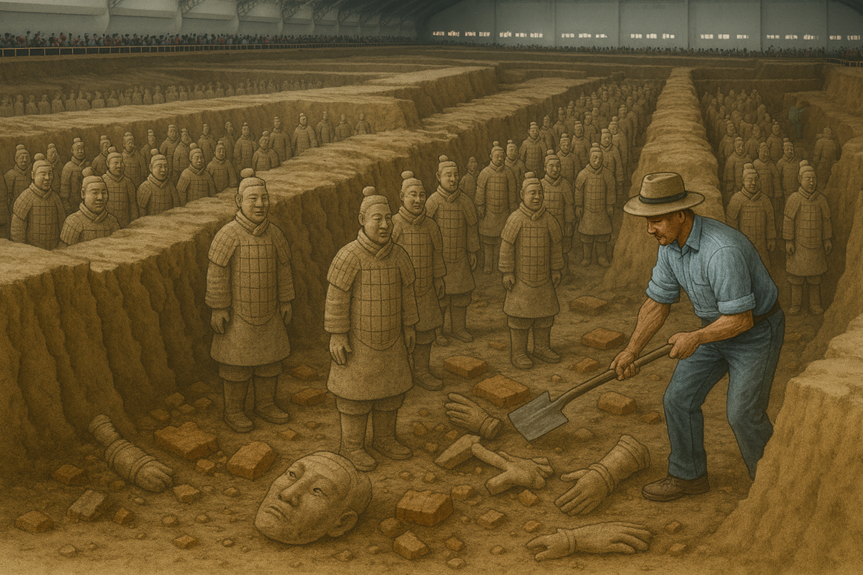
The Discovery
Farmers uncover buried army.
First Emperor of China’s mausoleum (Qin Shi Huang).
The soldiers.
Chinese ancient art.
The problem.

Slide 5
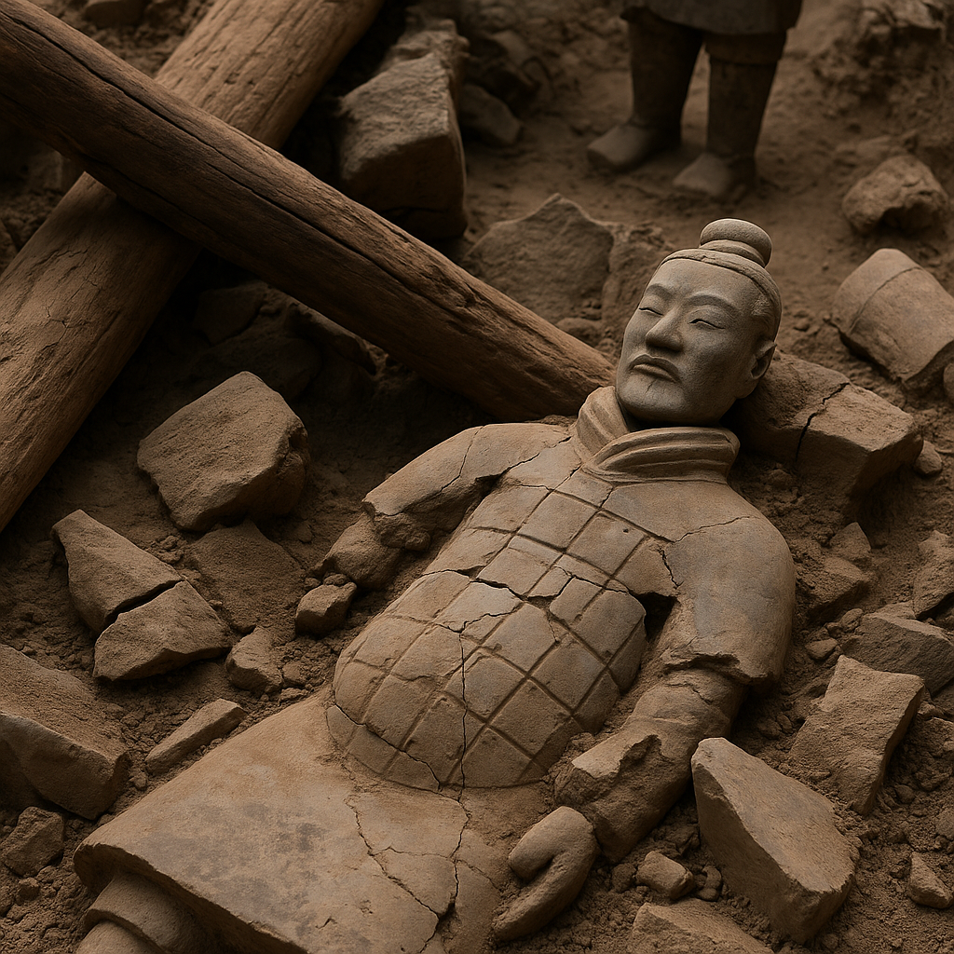
Problems Conservators Face
Fragility of the warriors.
Collapsed roof beams.
Cracking as soil was removed.
Statues in hundreds of fragments.
Sensitivity and vulnerability
to the elements.

Slide 6
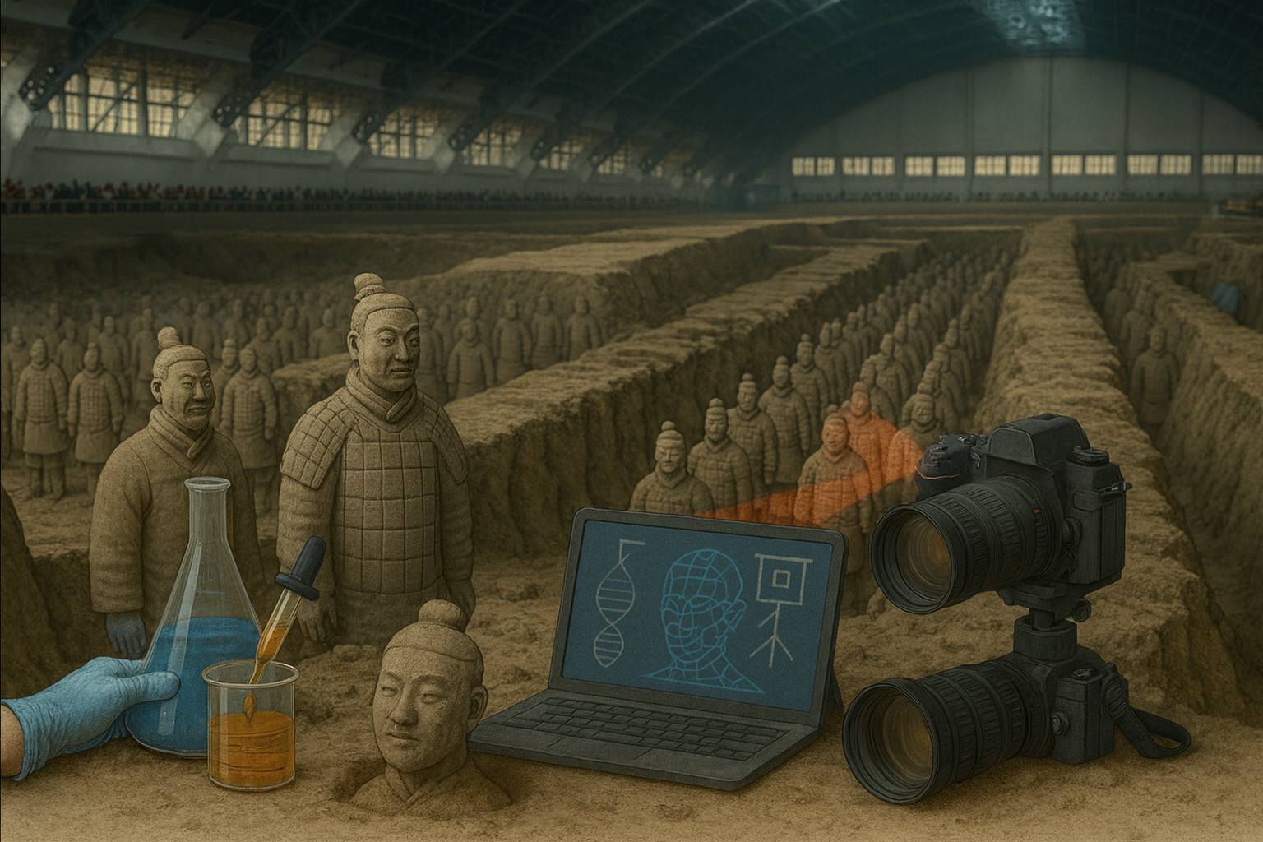
Scientific Techniques
Slowing down excavation
Thousands uncovered quickly.
Chemical stabilisation
Fragile paint.
Polyethylene Glycol (PEG).
Technology
Digital modelling.
Replicas.
Infrared imaging and X-ray fluorescence.

Slide 7
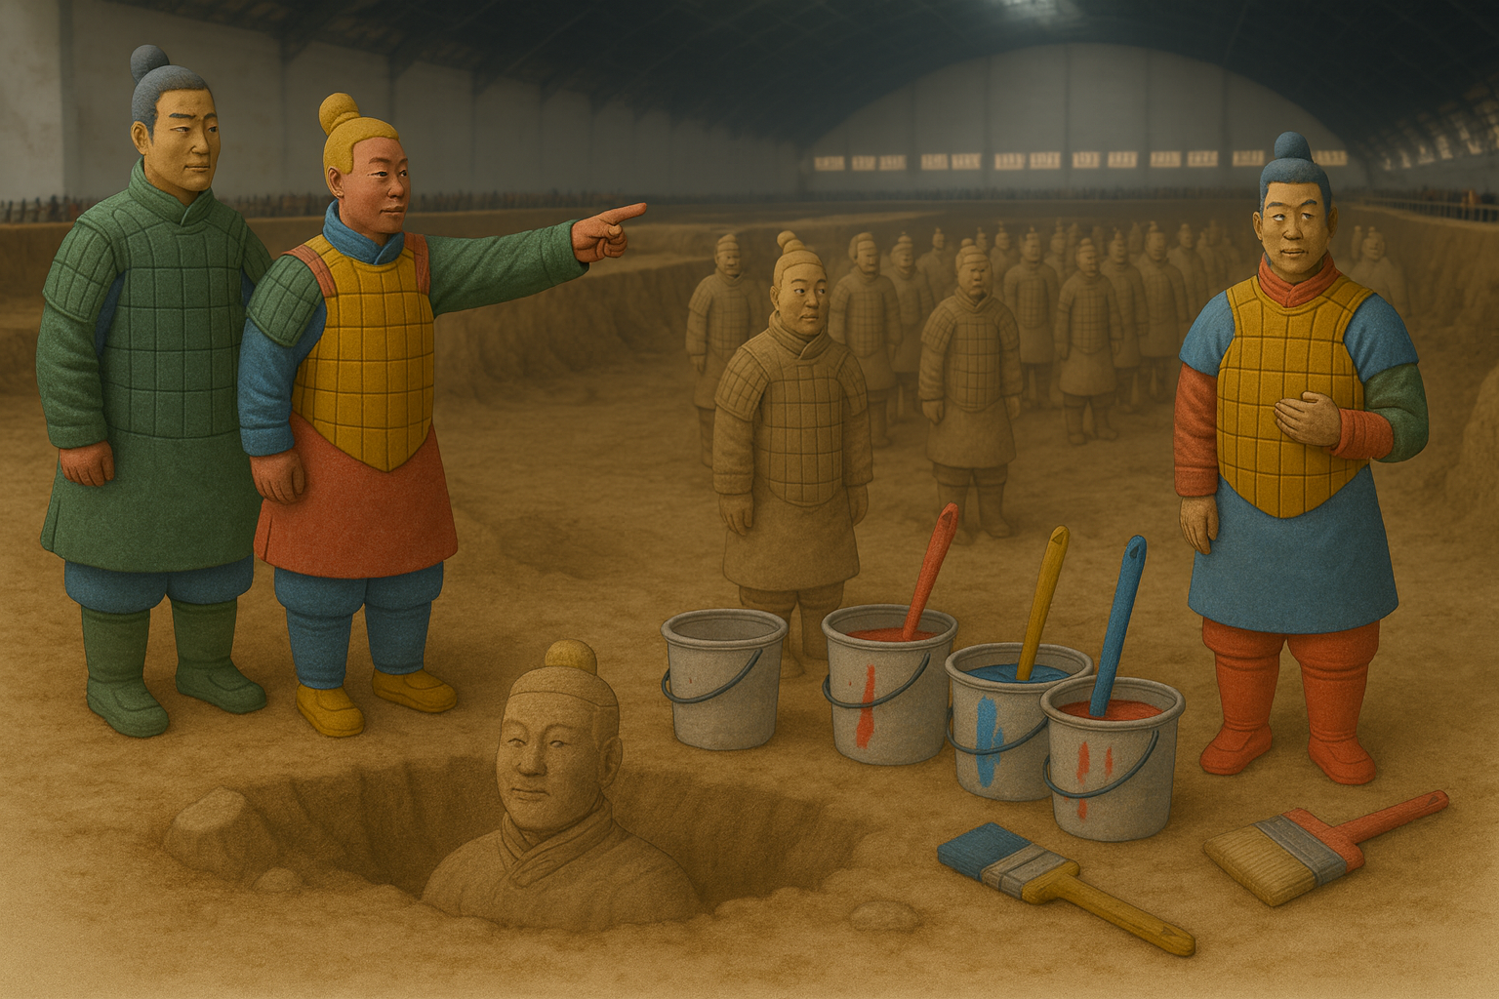
Debates
Restoration
Brightly coloured and life like.
Ancient China = back to life.
Preservation
Falsify past.
Authenticity = more valuable.
Original evidence = lost for ever.
Tension between restoration and preservation common in heritage management.

Slide 8
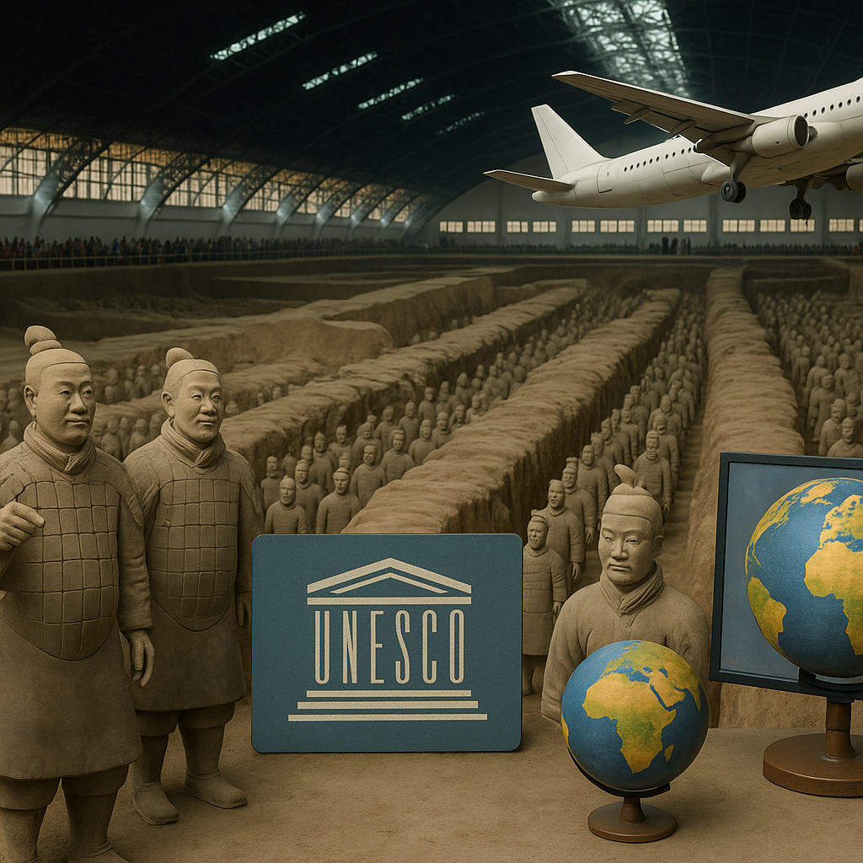
International Cooperation
Crucial to address challenges.
1980s = development of new conservation methods.
UNESCO = world heritage site.
International exhibitions: controversial.
Mausoleum of the First Qin Emperor

Slide 9
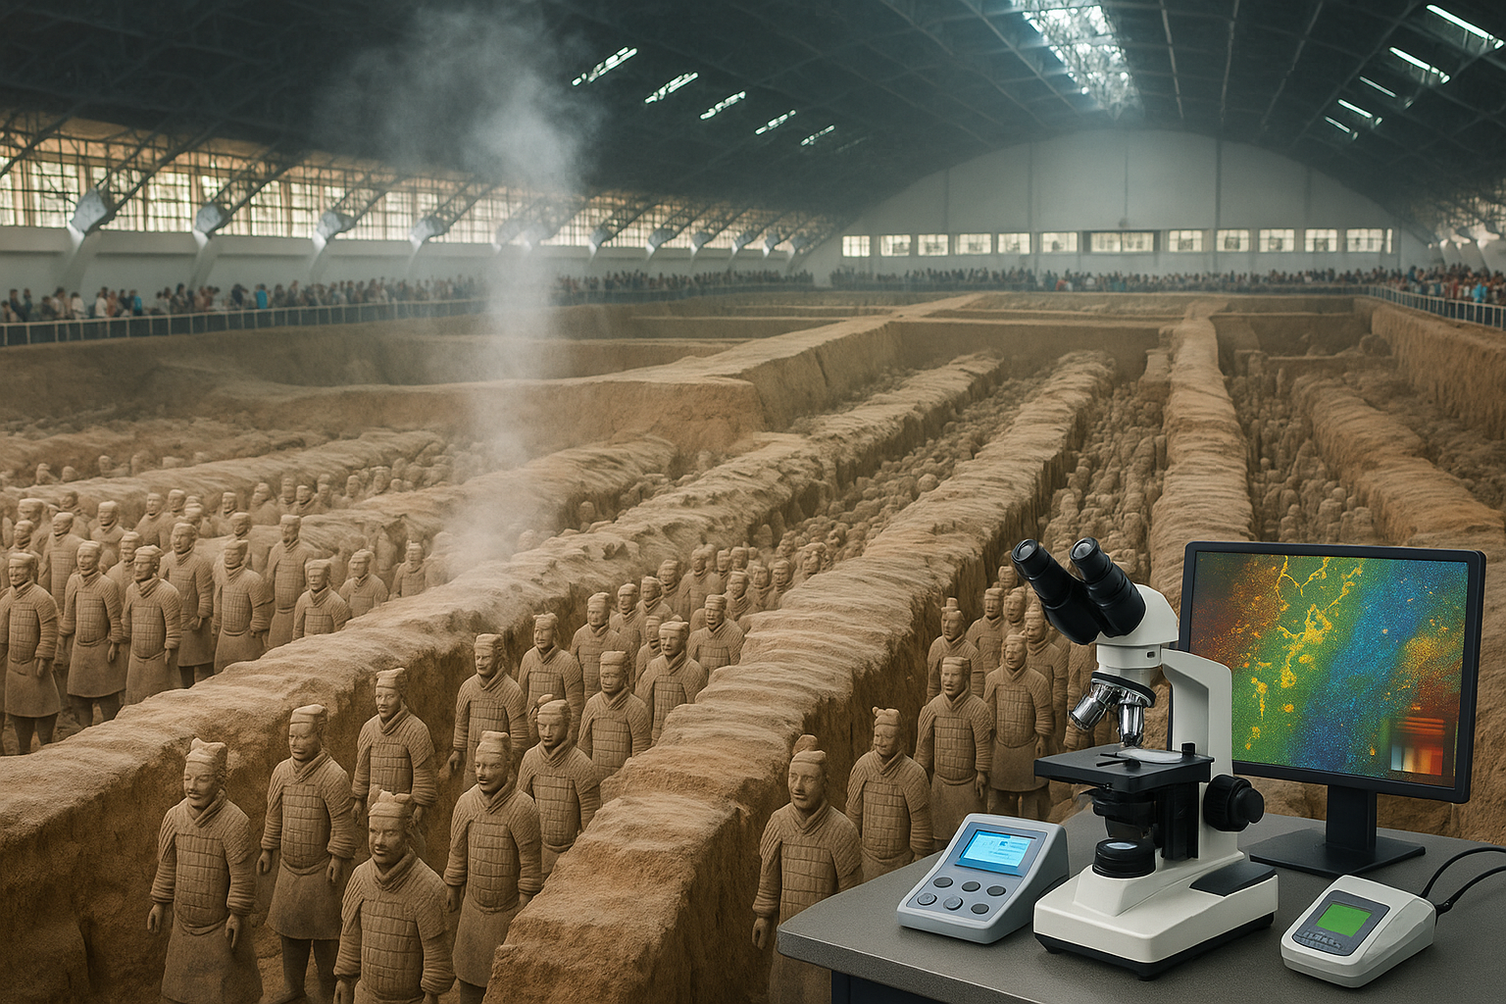
Ongoing Risks
Tourism
Human presence affects the fragile clay.
Pollution
Soil chemistry and terracotta.
Cost
Laboratories, staff, monitoring equipment and research.

Slide 10
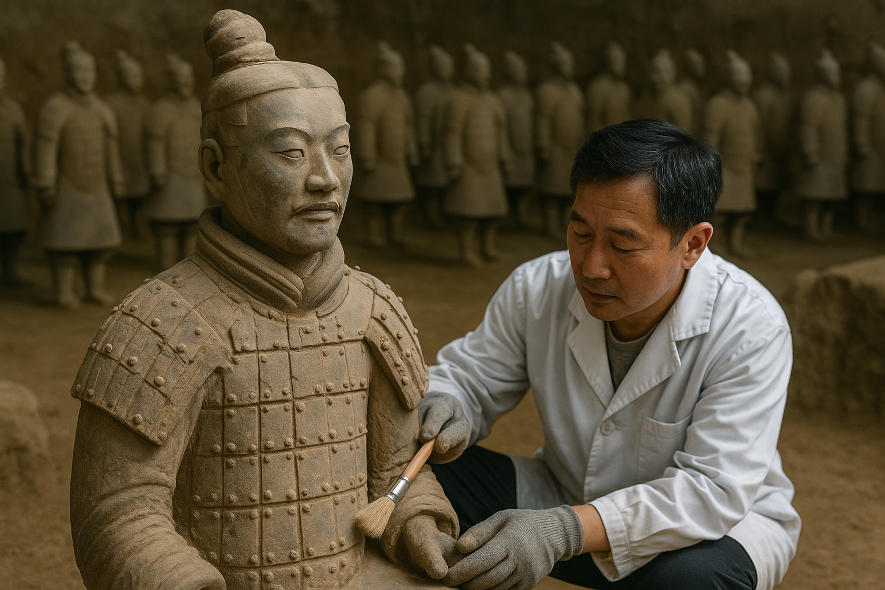
Broader Significance
Conserving the statues
Preserving a story.
Ambitions of the emperor.
Skills of ancient craftsmen.
Cultural identity.

Slide 11
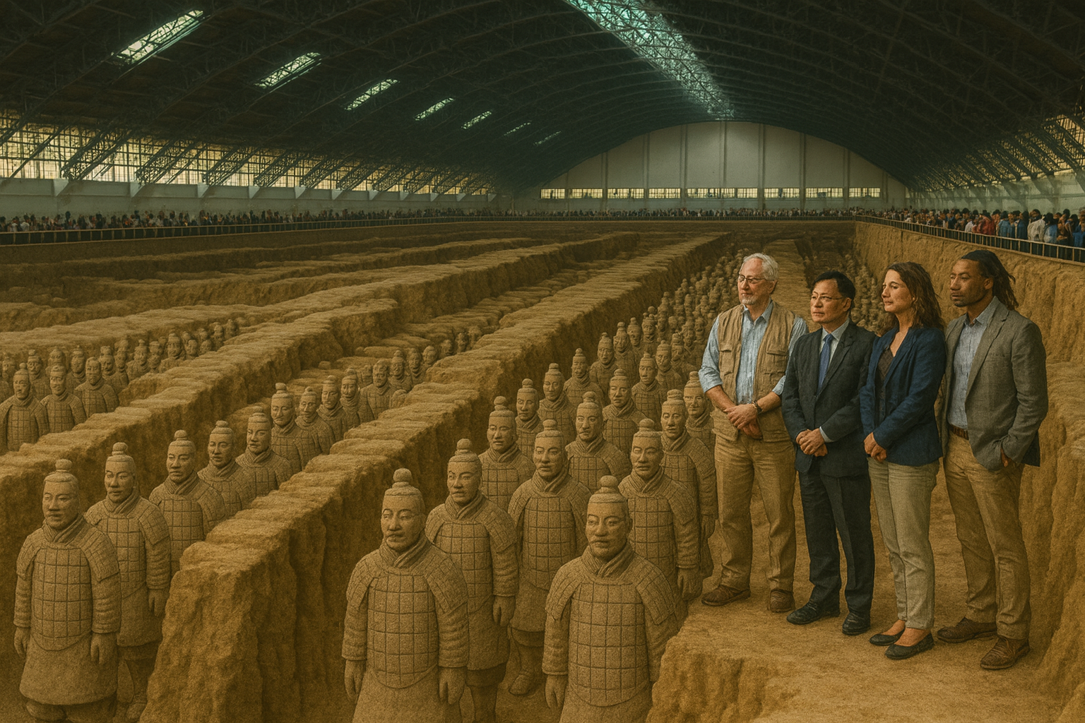
Conclusion
Complex project.
Scientific, ethical and international collaboration.
Humanity’s shared heritage.
Protection.
Preservation.

Slide 12
References
Branigan, T. (2015) The Terracotta Army: China’s First Emperor and the Birth of a Nation. London: Thames & Hudson.
Liu, Y., Li, Z. and Xu, H. (2018) ‘Conservation challenges of the Terracotta Warriors: Material deterioration and environmental risks’, Journal of Cultural Heritage, 34, pp. 45–56. doi:10.1016/j.culher.2018.02.010.
Wang, X. and Zhang, L. (2020) ‘Polyethylene glycol treatment for the preservation of fragile terracotta figures’, Studies in Conservation, 65(7), pp. 389–402. doi:10.1080/00393630.2019.1709513.
Smith, C. and Wang, J. (2022) ‘Balancing authenticity and restoration: The case of the Terracotta Army’, International Journal of Heritage Studies, 28(5), pp. 623–639. doi:10.1080/13527258.2021.1968732.
UNESCO (2024) Mausoleum of the First Qin Emperor. Available at: https://whc.unesco.org/en/list/441 (Accessed: 21 September 2025).

